Slide 1
Music Generator
Final project presentation CSCI 6221
Team member:
A Zhenyi Yuan
B Dongfang Zhao
C Yihan Chen

Slide 2
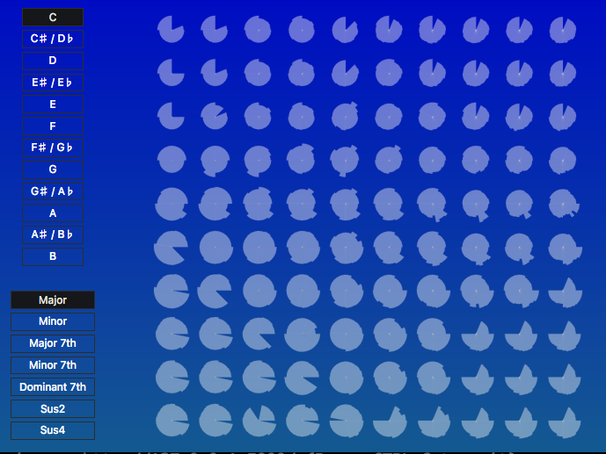
1.Introduction
2. Model
3. Our features
4. Our values
Notes:
四个部分：
1.为什么做这个
2.项目功能
3.和其他比较，我们的优点
4.模型介绍

Slide 3
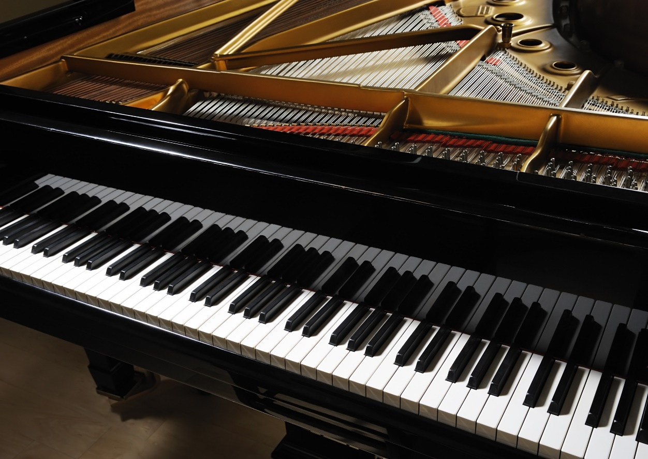
1.Introduction
Why we do this?
Help non-professional people create music
Provide ideas and inspirations to professional composer
Generate multiple music quickly with your own prefer
Notes:
这里列出了三个项目的出发点

Slide 4
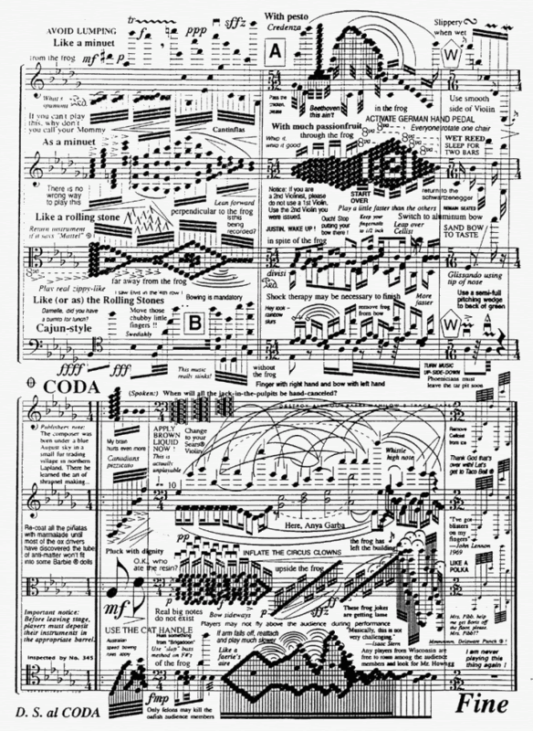
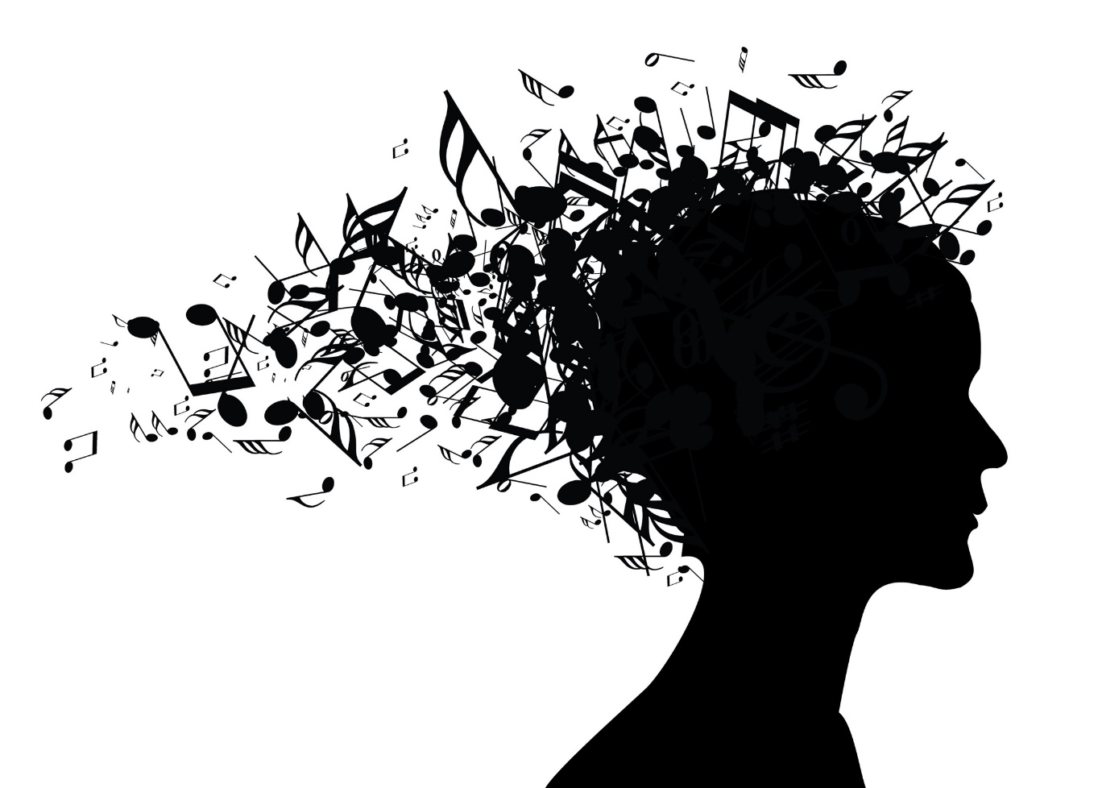
Your private composer for non-professional
Complex
Much idea
Notes:
人们喜欢音乐，对于新手，难学；很多想法却不成曲子；

Slide 5
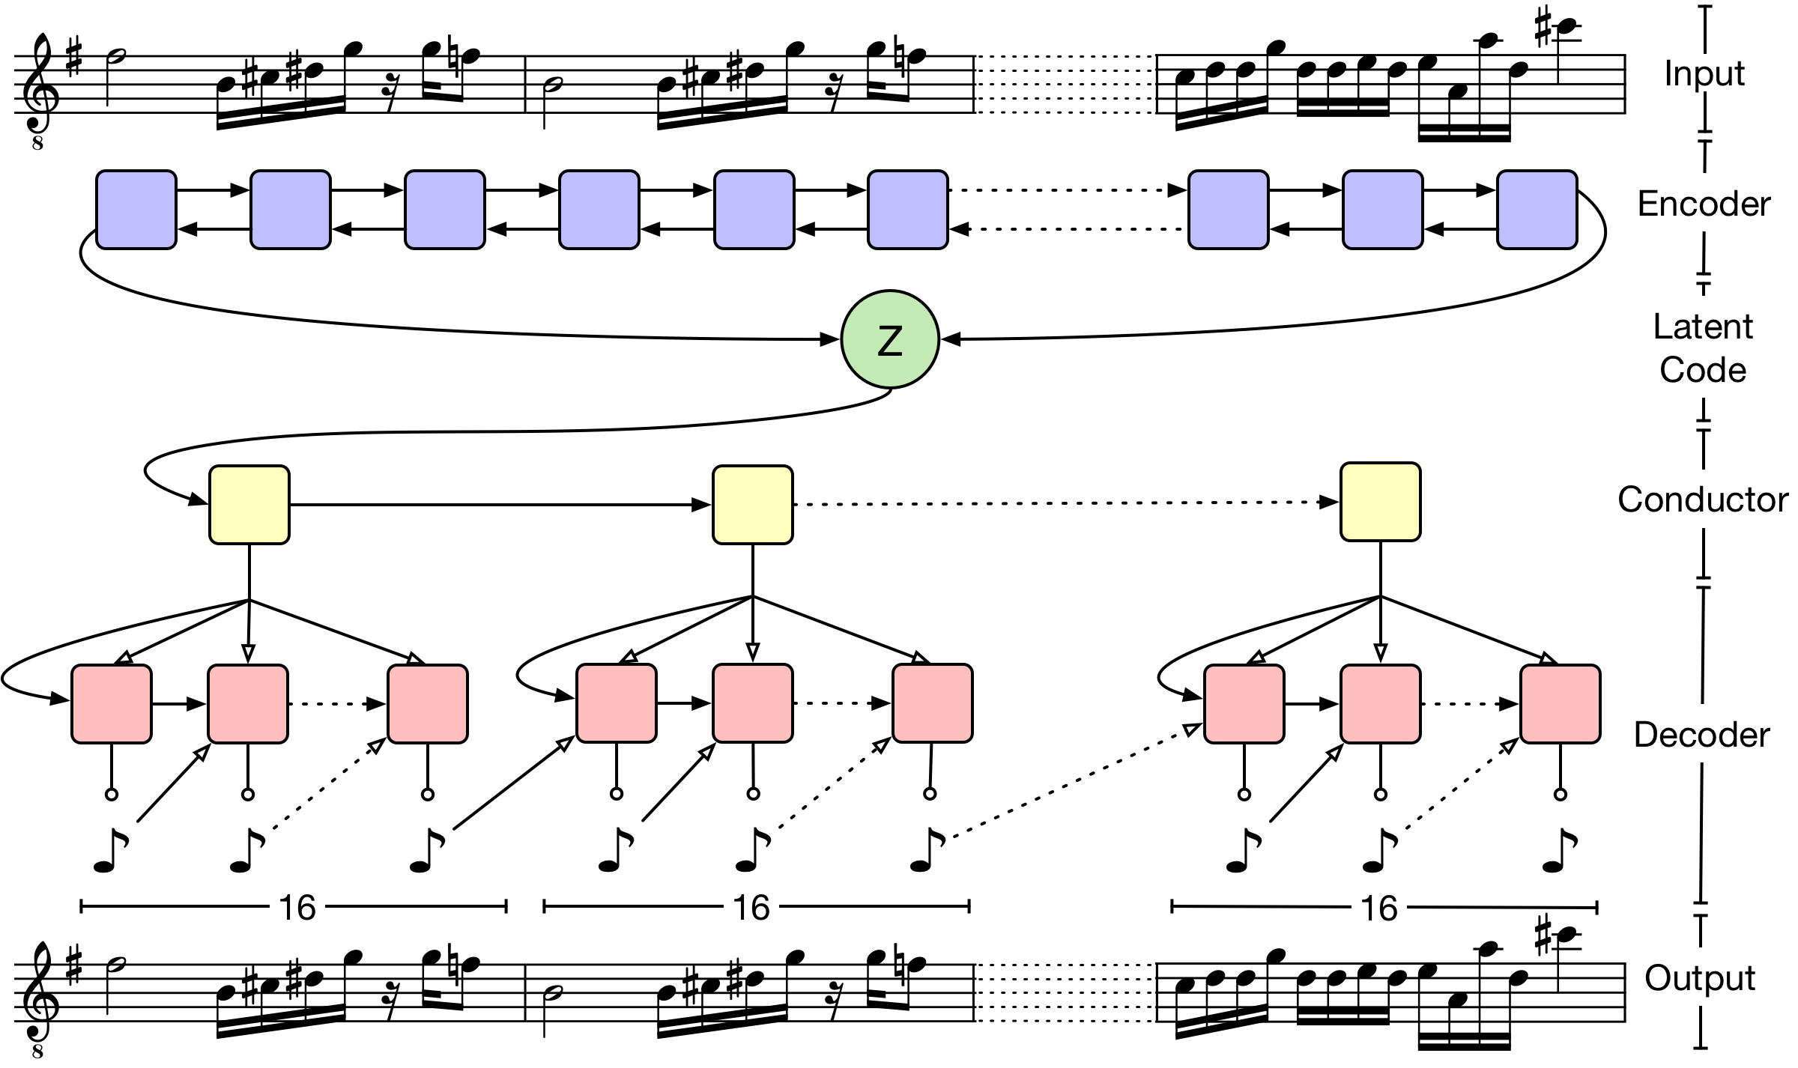
2.Model
One layer LSTM with 2048 state sites and output 512 latent dimension
Fully-connected layer followed by tanh activation
Two layer LSTM, each module of the second layer is made up by 16 embedding matrix generated from the first layer
Roberts, A., Engel, J., Raffel, C., Hawthorne, C., & Eck, D. (2018). A Hierarchical Latent Vector Model for Learning Long-Term Structure in Music. arXiv preprint arXiv:1803.05428.

Slide 6
3.Our Features
1. Copyright-free
2. 100 generated tones by LSTM
3. Real-time result feedback
4. MIDI file output

Slide 7
4.Our Values
Jukedeck
https://www.jukedeck.com/make/tracks/browse
Fake Music
https://www.fakemusicgenerator.com/
Beat Blender
https://experiments.withgoogle.com/ai/beat-blender/view/
Latent Loops
https://teampieshop.github.io/latent-loops/

Slide 8
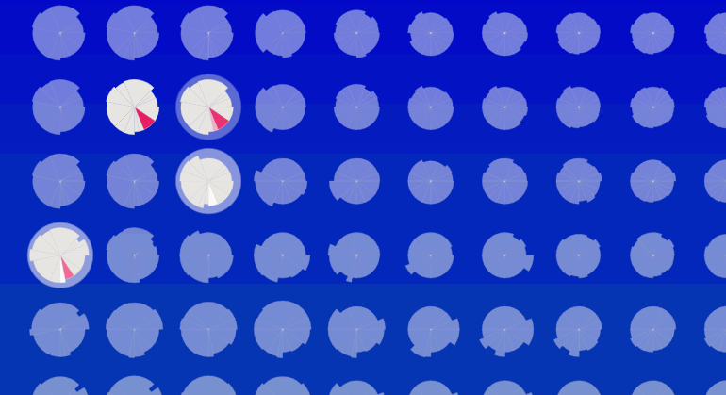
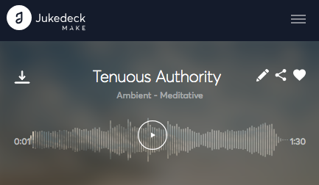
4.1 Compare with Jukedeck
Copyright-free
Our project generate copyright-free, original music, which means you can use your music in any ways you like without worrying about copyright problem.

Slide 9
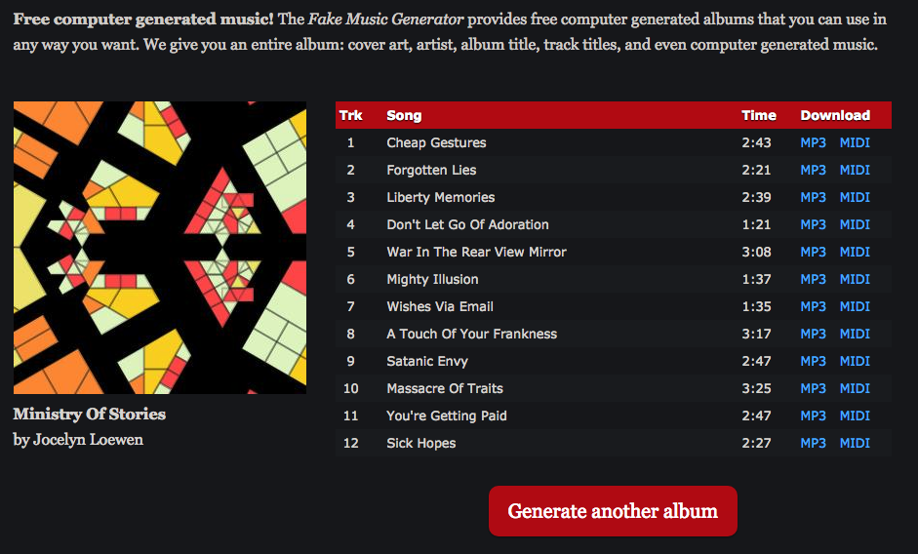
4.2 Compare with Fake Music
Real-Time feedback
Our project gives users a real-time feedback of their creation, you can manipulate them as you like.

Slide 10
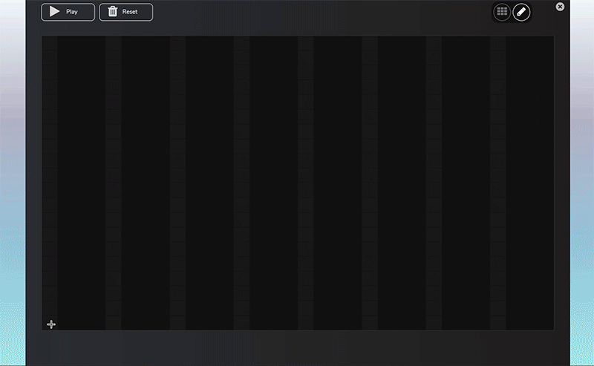
4.3 Compare with Latent Loops
Resonance Music
Our project can mix different music pieces together at the same time, to create brand-new experience.

Slide 11
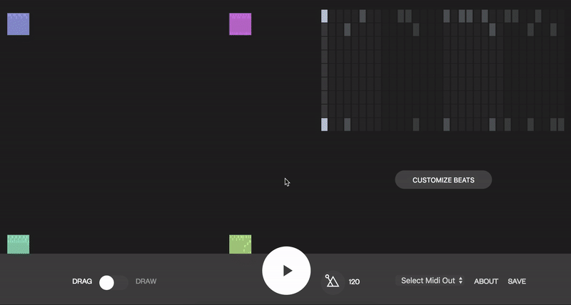
4.4 Compare with Beat Blender
MIDI File Output & Major Selection
Our project can generate MIDI file and also provide more custom settings for users.

Slide 12
4.5 Conclusion
 | Jukedeck | Fake Music | Beat Blender | Latent Loops
Our Value | Copyright-free | Real-time | Mix Music | Custom settings

Slide 13
THANK YOU
Innovation is the vitality of science building —— Isaac Asimov

